Slide 1
Sport Photography Booking
By G. Mohammed Kaif-3BR23CA030
Janakiram RS-3BR23CA039
Tahir Tamam-3BR23CA109
Avni Sodani-3BR23CA009
Aiman Fathima-3BR23CA005
Khadeeja-3BR23CA050

Slide 2
Objective:
To streamline the process of scheduling, managing and delivering sports photography services by providing a platform for clients
To simplify the Booking of sport photographers
Enhancing user experience by user friendly interface between clients and photographers.
This programme aims to enhance convenience, efficiency and customer satisfaction in the sports photography industry

Slide 3
Problem Statement: To book professional photographers for sports event photography
Content:
Welcome Message
Client Registration
Event calendar
Event Management
Booking cancellation

Slide 4
Key features:
Client registration and login
Booking and scheduling the photography event
Viewing the booking
Cancellation of the booking

Slide 5
Methodology:
Welcome to the booking system
ffhfgfgfffffds
Add booking
w
View booking
Cancel booking
Usage of Classes, functions, objects, iterative, conditional statements, Hoops ,variables to develop a Python program that can act for creation, updation, viewing, and deletion of data within a database.
EXIT

Slide 6
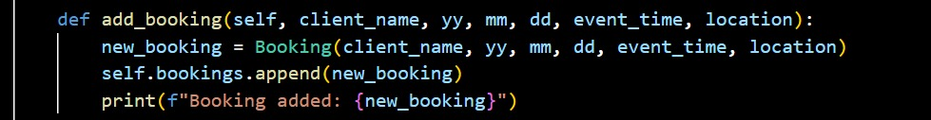
New booking:
New bookings can be made that require client and event details.
Limitation: Entry of valid date and time.
Name validation is also checked
Code:

Slide 7
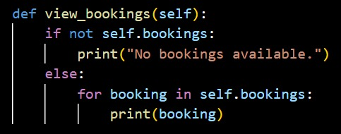
View booking:
The booking that's made can be viewed within this scope of code.
Code:

Slide 8
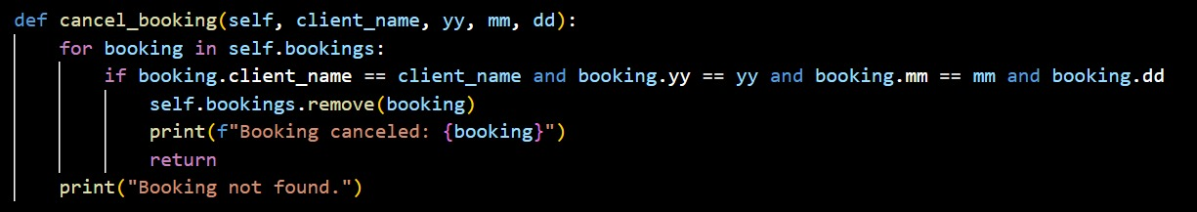
Cancel Booking:
The booking is cancelled within the scope of this code
The Name and Date of the event used for booking to be entered accordingly
Code:

Slide 9
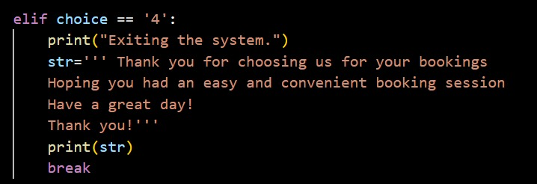
Exit the program:
The program is exited after the required usage as per the client
Code:

Slide 10
Conclusion:
The sports photography booking system provides an innovative solution that transforms how clients book photographers for sports by integrating
a user-friendly platform with features such as real-time booking.
By using modern technology and cloud storage solutions, this system ensures quick secure and efficient service to clients.
It positions itself as a vital tool for modernizing the sports photography industry offering convenience, transparency and professional quality at every step.

